Slide 1
Social Narrative
Sensory Friendly Performance of
The Secret Garden

Slide 2
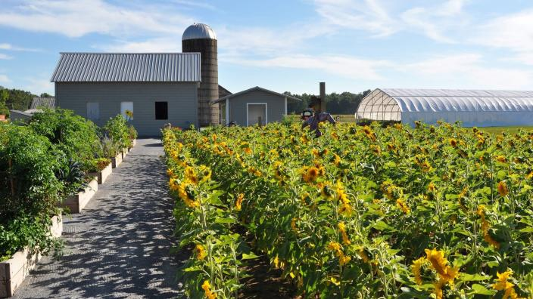
I am going to see a play today!
I am going to The High Tunnel at Pitney Meadows Community Farms to see The Secret Garden today!

Slide 3
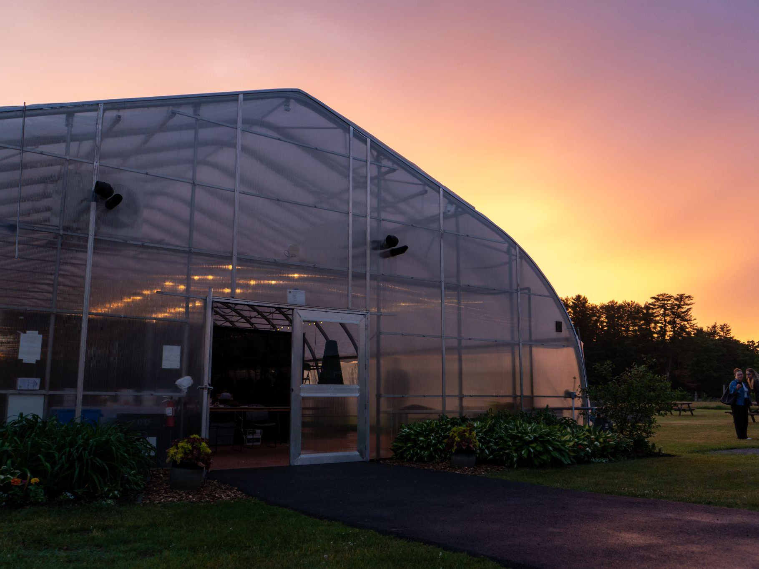
Arriving at the Theater
When I arrive at the theater, I will wait in line. When it is my turn, the usher will ask my name and then I will go into the theater.
There may be other people in line and that is okay.
If I need more space I can use the sensory-friendly entrance (follow the signs).

Slide 4
The Playbill
As I enter the theater lobby, the usher will give me a Playbill that shares information about the play and the actors I will see performing today!

Slide 5
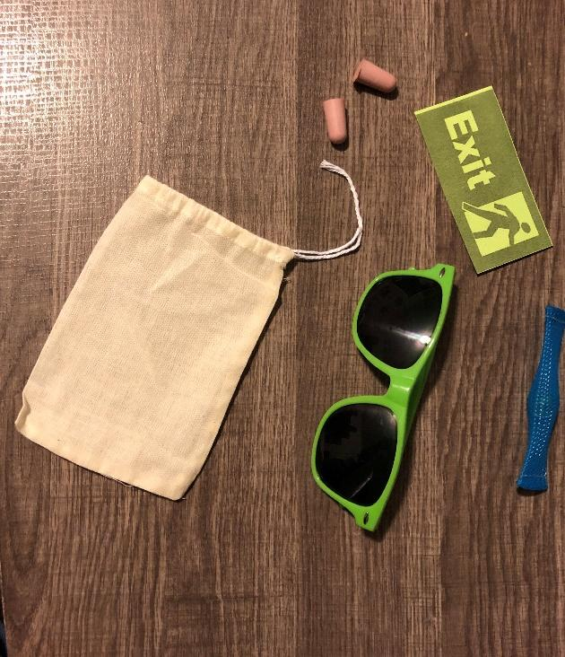
The Sensory Kit
The usher will also give me a Sensory Kit. In the Sensory Kit, there are fun items to help me enjoy my time at the theater!
Sunglasses: If the lights are too bright!
Earplugs: If the sounds get too loud!
Fidget: To squeeze if I am stressed.

Slide 6
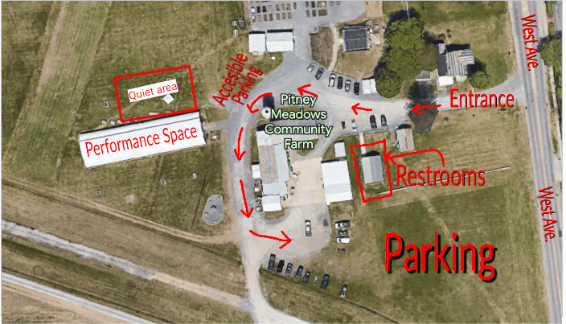
Entering the Main Theater
Then it will be time for me to enter the Main Theater where the play will be performed by the actors.
An usher can show me where I will sit during the performance.
The High Tunnel at Pitney Meadows Community Farms has many seats. I might have to go up a few steps to get to my seat.

Slide 7
Some important information about our Sensory Friendly Performance
At today’s show there will be supports I will be able to use if I need to.
A trigger list so I know when there will be sudden movement or loud noises or bright lights during the performance.
A map of the how the theater is set up and where I can find the Quiet Area and sensory kits.
Quiet Area if I need a break that is located just outside through the sensory-friendly exit.

Slide 8
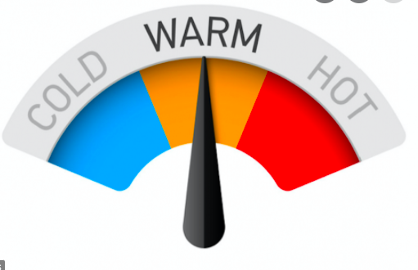
More information about our Sensory Friendly Performance!
The temperature in the theater is usually on the warmer side during the day, but may be colder depending on the weather. Make sure to dress in comfortable clothes and bring layers so you can relax and enjoy the show!
You can also bring a water bottle with you to the show or purchase one in the lobby. Audience members can take their water bottle into the Main Theater. If you feel warm, you can take a cool drink of water while you watch the show!

Slide 9
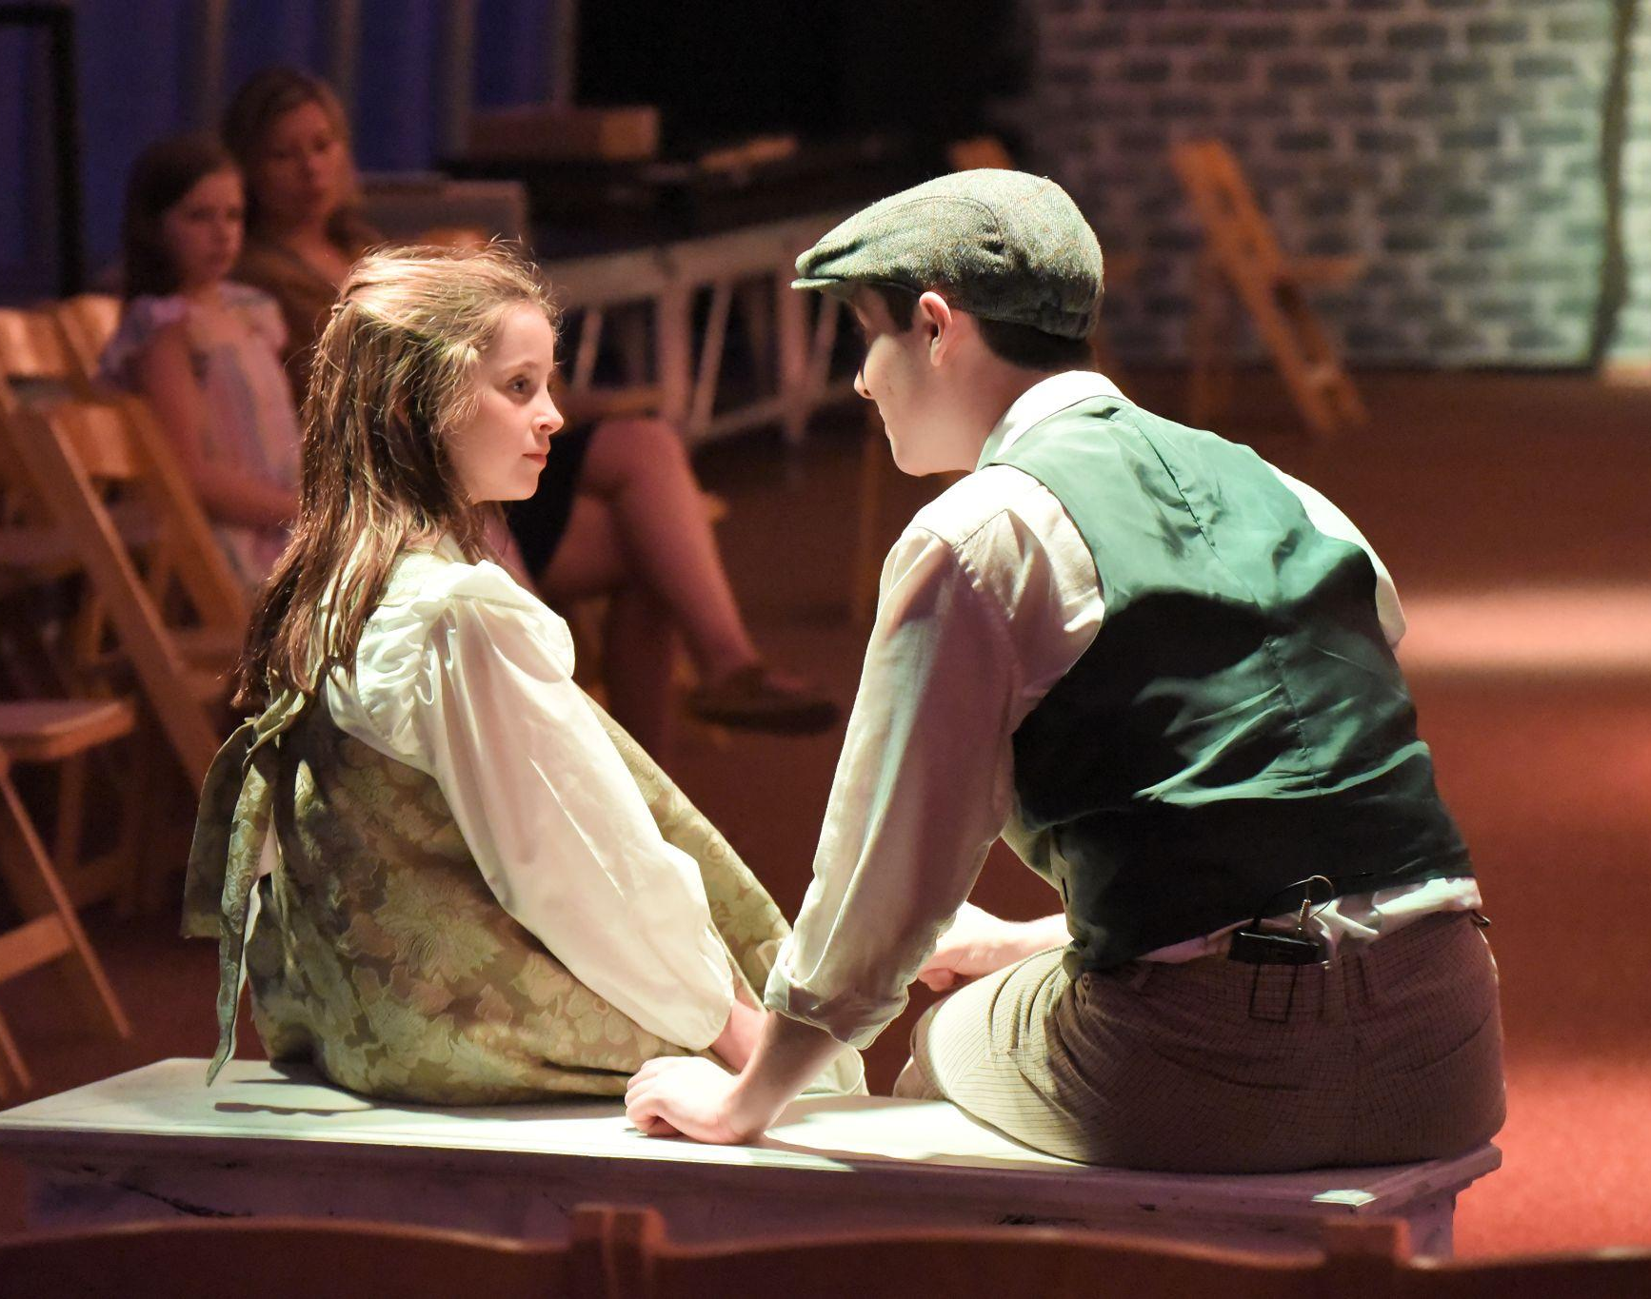
Actors on the Stage
The stage will be in the middle of the theater and the audience will sit on either side of the stage.
During the performance, the actors will talk and move around the stage and sometimes may get physically close to the audience. I do not touch the actors, but I can listen and watch them perform the play.

Slide 10
Break Area
The Break Area is located just outside the performance space and is open air. In the event of rain going to the car will be more quiet.
If I start to feel overwhelmed by the lights or loud noises, I can ask an usher to help me find the Break Area.
In the Break Area there are places to sit, headphones I can borrow, and other calming activities. When I am ready, I will return to my seat to continue enjoying the show!

Slide 11
Before the Show Begins
Before the show begins, the actor who plays Major Shelly (his real name is Eric, he is also the director) will come on stage to do a pre-show introduction.

Slide 12
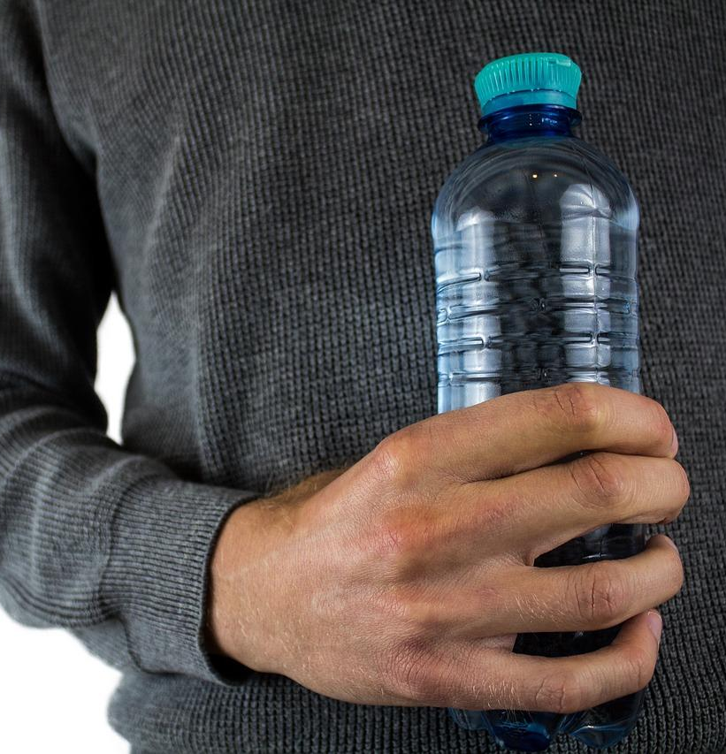
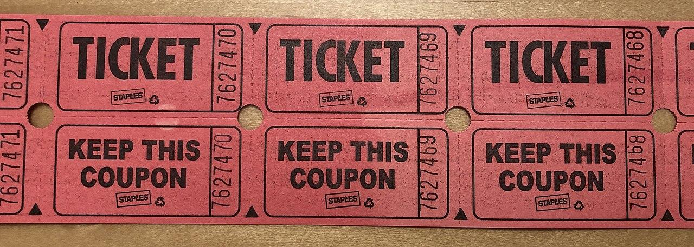
Intermission
The play has a break in the middle called an Intermission. During Intermission I can leave my seat. This is a time that I can use the bathroom, get a drink of water, or visit the Break area.
There will be someone selling raffle tickets and concessions. The raffle tickets will have a fixed price and instructions on how to use them that I can read on a sign. The concessions do not have a fixed cost but rather are available by “free-will donation”. I will only take what I need and I will give at least $1 per item, or more if I would like to. These donations help the theater to put on more shoes like this one!
When Intermission is over, it will be time for me to return to my seat. The theater will get Break and then the final act of the play will begin.

Slide 13
When to Clap for the Actors
During the show there are times that I can clap for the actors.
For this Sensory Friendly performance, I will clap using the ASL sign for” applause”. I will learn the “applause” ASL sign on the day of the performance.
I can clap using the ASL sign for “applause” after each song ends.
I can clap using the ASL sign for “applause” right before the Intermission.
The final time I can clap using the ASL sign for “applause” is at the end of the show!
If anyone forgets this request and I hear clapping that bothers me, I can use my headphones or the earplugs that are in my Sensory Kit.

Slide 14
Leaving the Theater
When the play is over, I will leave the theater with my friends and family.
I can exit through the sensory-friendly exit if I want to.
There will be many people leaving the theater at the same time, so I need to be patient.

Slide 15
Thank You!
I had a great time at the Theater today seeing the play, The Secret Garden
I can’t wait to come back and see another play!

